Slide 1

Check Your Thermal Exhaust Port: 10 Vulnerabilities Your Web App Probably Has Right Now
scottsauber
Slides at scottsauber.com

Slide 2
Audience
Anyone with a web app
New to security
Security Experts

Slide 3
Agenda
Series of lightning talks
SQL Injection
Directory Traversal/Backtracking
Broken access control
Package vulnerabilities
Guids vs Ints
Container Vulnerabilities
JWT Stale Roles
Data Leaking
Clickjacking
Lack of WAF

Slide 4
Goals
Exposure to security vulnerabilities
Not just OWASP Top 10
Check yourself before you wreck yourself

Slide 5

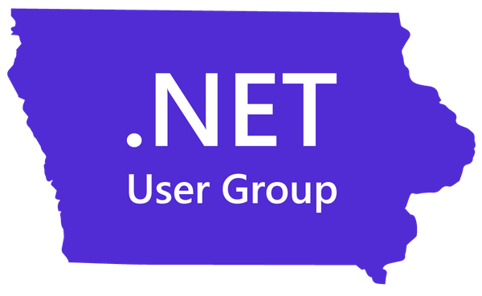

Who am I?
Director of Engineering at Lean TECHniques
Co-organizer of Iowa .NET User Group
Microsoft MVP
Friend of Redgate
Blog at scottsauber.com

Slide 6

Stuff I’ve Heard Clients Say

Slide 7
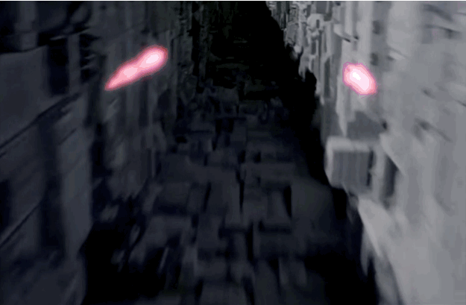
One problem

Slide 8

One problem

Slide 9
It’s the same with web apps
One vulnerability can take down an otherwise rock solid web application
There are dozens of attack types
We’re just going to cover 10

Slide 10

SQL Injection

Slide 11
SQL Injection
What is it?
Allows attackers to execute queries against your database
Why should I care?
They can get at some or all of your data
They can change or delete some or all of your data

Slide 12
SQL Injection
How do I fix it?
Parameterize Queries

Slide 13
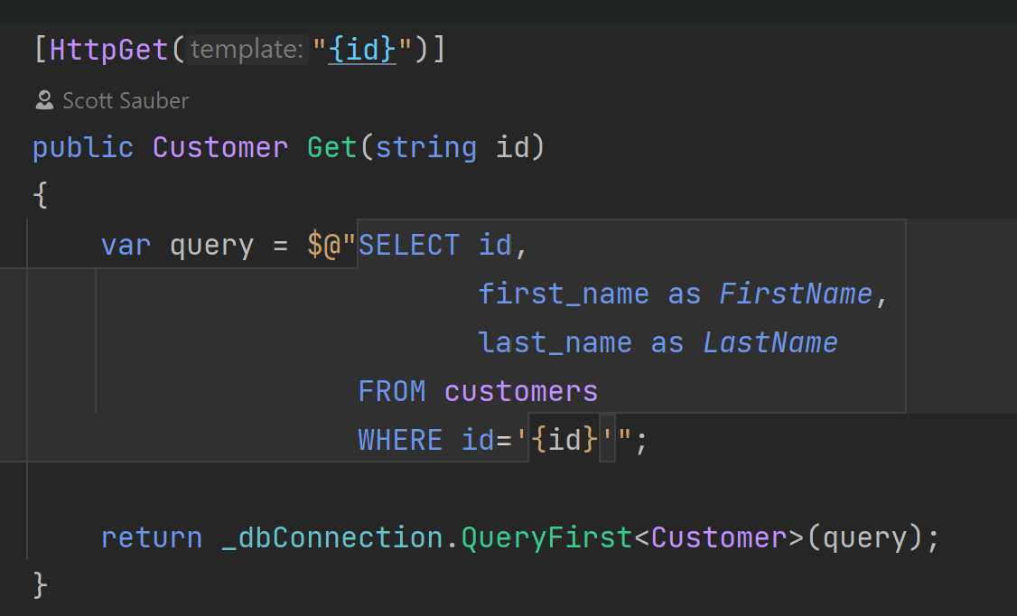
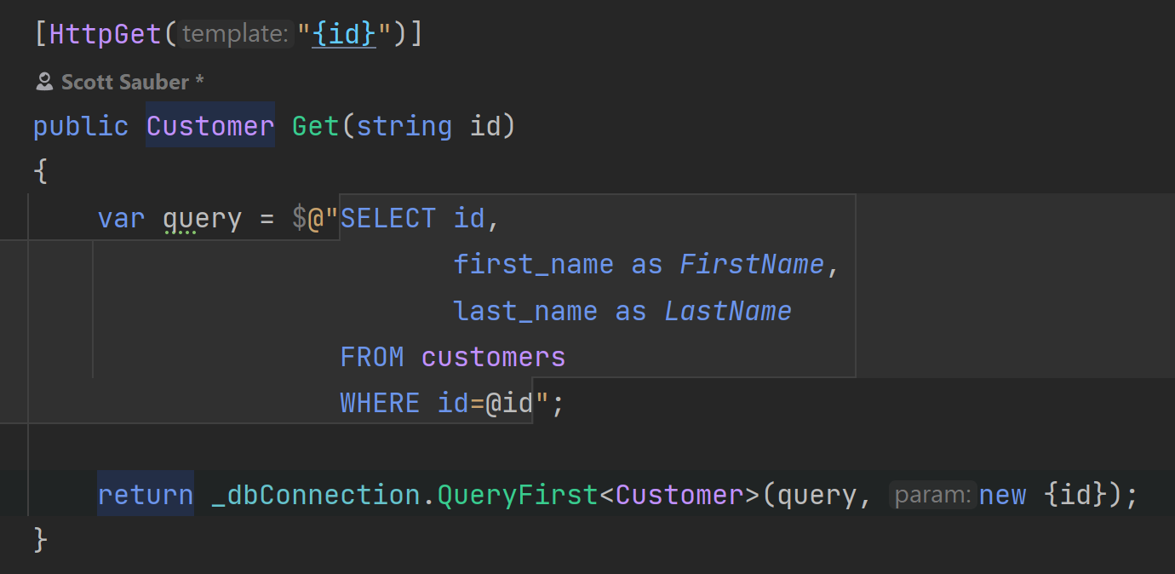
Vulnerable to SQL Injection
Not Vulnerable to SQL Injection

Slide 14
SQL Injection Demo

Slide 15

Directory Traversal (aka Backtracking)

Slide 16
Directory Traversal
What is it?
Allows attackers to access folders and files they shouldn’t have access to
Why should I care?
Exposes data, potentially sensitive data

Slide 17
Directory Traversal
How do I fix it?
Filter user input
Do not intake a path from a user
One approach – file request based on GUID, path stored in database

Slide 18
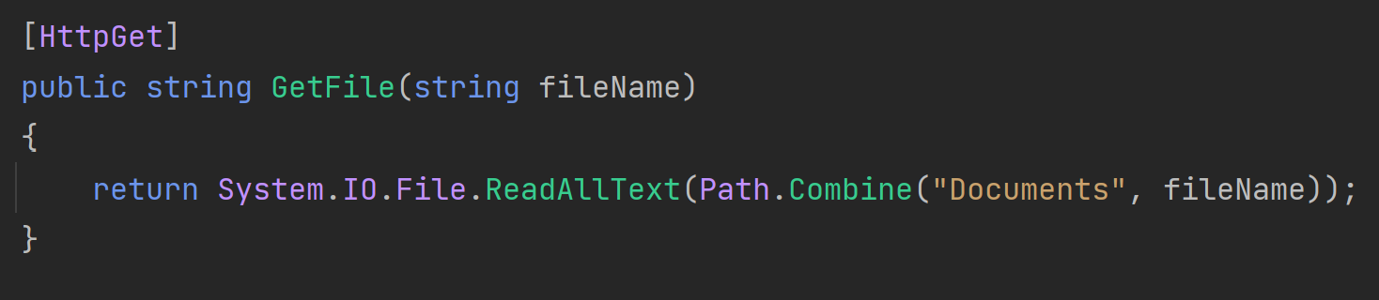
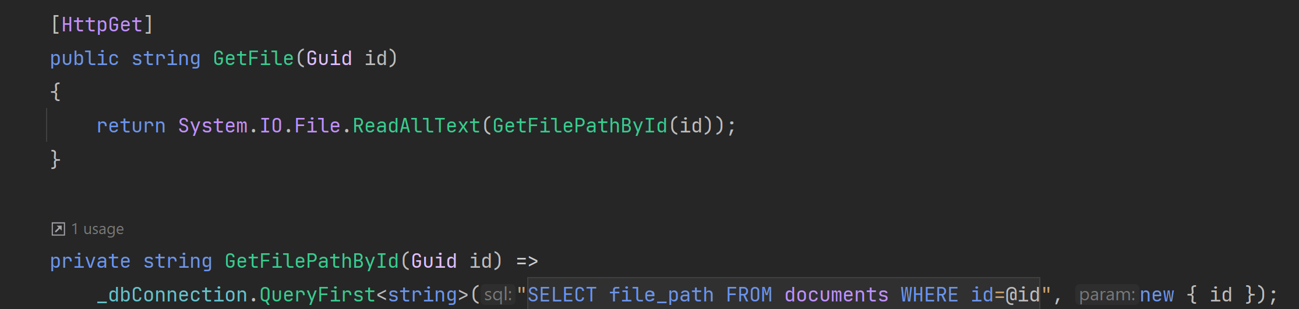
Vulnerable
Not Vulnerable

Slide 19
Directory Traversal Demo

Slide 20

Directory Overwriting

Slide 21
Directory Overwriting
What is it?
Allows attackers to overwrite files or folders they shouldn’t have access to
Why should I care?
Loses valid files or folders

Slide 22
Directory Overwriting
How do I fix it?
Do not use the filename from the user to save the file to disk
On upload, rewrite the file path (i.e. use a GUID for a file name) and store path in the DB

Slide 23
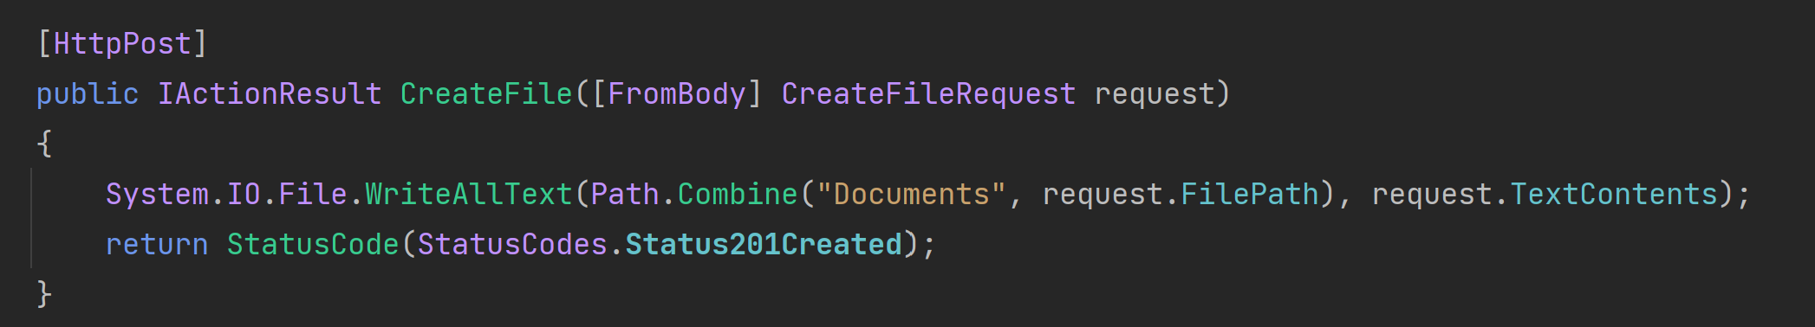
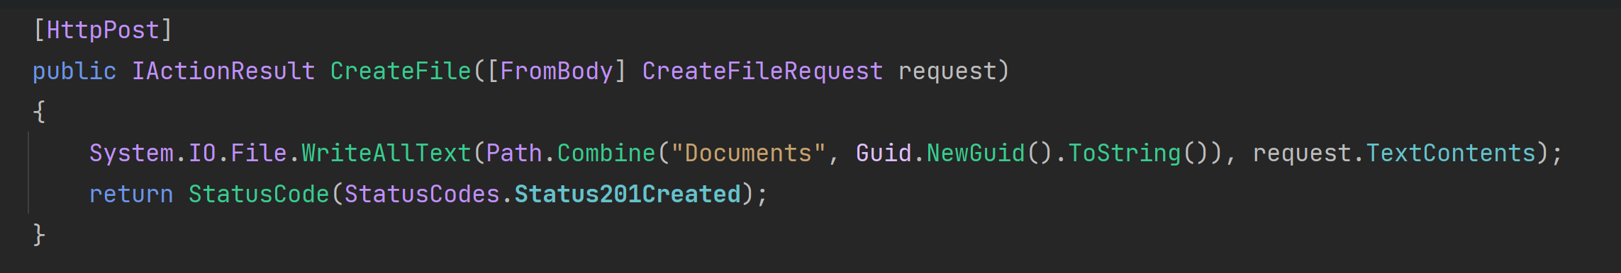
Vulnerable
Not Vulnerable

Slide 24
Directory Overwriting Demo

Slide 25
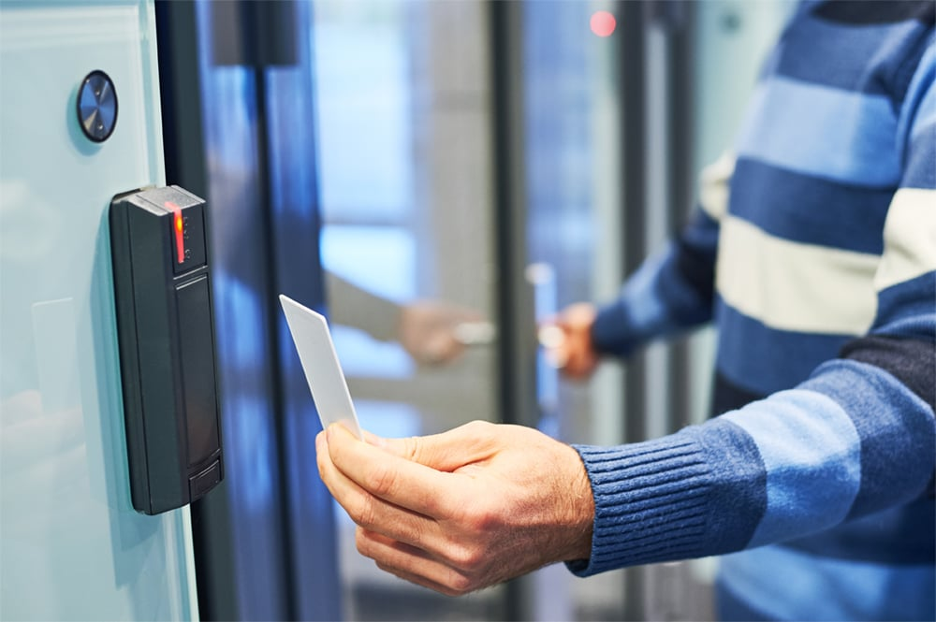
Broken Access Control

Slide 26
Broken Access Control
What is it?
Allows users to perform actions that should be outside of their control
Why should I care?
Non-Admin users could perform Admin actions like Editing or Deleting data or viewing sensitive data

Slide 27
Broken Access Control
How do I fix it?
Enforce correct permissions SERVER SIDE (not just client side)
Client-side is just UX so they don’t see things that aren’t relevant

Slide 28
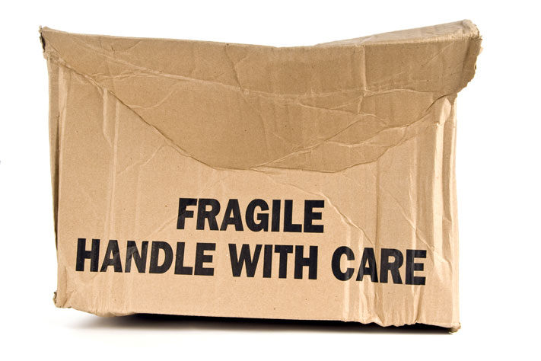
Package Vulnerabilities

Slide 29
Package vulnerabilities
What is it?
Outdated and/or insecure packages
Why should I care?
Depending on how the package is used, this could be a catastrophic vulnerability in your application

Slide 30
Package Vulnerabilities
How do I fix it?
Stay up to date on latest versions
Use maintained/supported packages

Slide 31
Open SSF Scorecard
https://securityscorecards.dev/
Assesses open source packages for security risks
Code Vulnerabilities
Maintenance (Dependency Updating, Frequent History, License, etc)
Continuous Testing (Tests, SAST, Fuzzing)
Source Risk Assessment (Branch Protection, Code Review, etc.)
Build Risk Assessment (Signed Releases, Pinned Deps, etc)

Slide 32
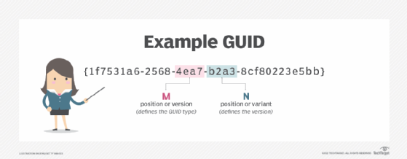
Using Ints instead of Guids

Slide 33
Using Ints instead of Guids
What is it?
Using auto-incrementing integers to to uniquely identify database rows
Why should I care?
Auto-incrementing ints can leak how much data is in the system (possible predictor of financials)
If Broken Access Control vulnerability is in place, they can easily enumerate your data

Slide 34
Using Ints instead of Guids
How do I fix it?
Use random Guids instead of Ints for primary keys
Yes it comes at a performance penalty… but will you notice?

Slide 35
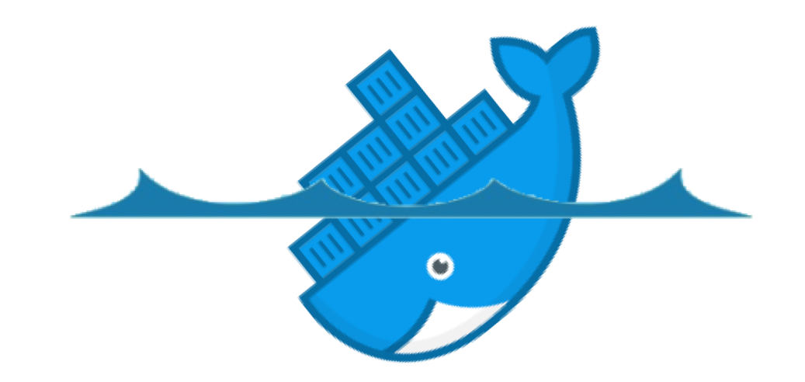
Container Image Vulnerabilities

Slide 36
Container Image Vulnerabilities
What is it?
Images provide an immutable artifact which is great for repeatability
The problem with immutable artifacts, is they don’t get updates
These images are used for deployments (i.e. Azure App Service/Container Apps, AWS ECS, etc)
Why should I care?
Depending on the vulnerability, your application may be partially or completely taken over

Slide 37
Container Image Vulnerabilities
How do I fix it?
Rebuild images regularly
Use a scanner
Use a PaaS service such as Azure App Service that auto-upgrades framework versions (i.e. .NET, Java, etc)

Slide 38
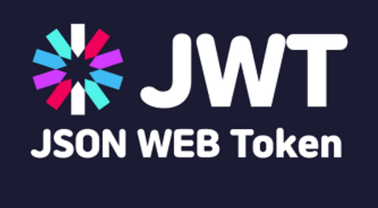
JWT Stale Roles

Slide 39
JWT Stale Roles
What is it?
Often times, web applications put role data in their JWT so they don’t have to go fetch it every time.
Why should I care?
The problem is, if a new permission is added or removed, the roles on the JWT will be stale
For example, if someone is terminated their JWT (and therefore access) might still be valid if you do local introspection

Slide 40
JWT Stale Roles
How do I fix it?
Round trip to get roles from the database every time
Performance or Security – pick one
Understand the tradeoffs

Slide 41
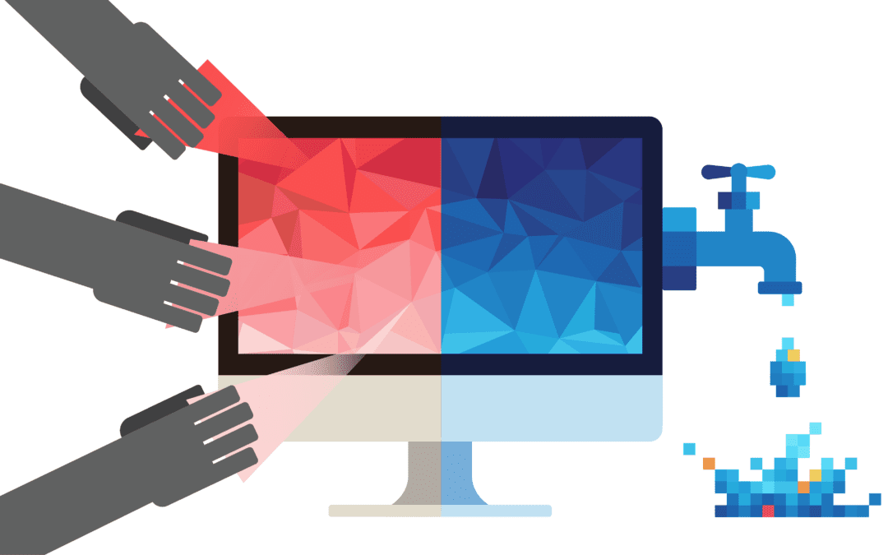
Data Leaking

Slide 42
Data Leaking
What is it?
Exposing too much data
Why should I care?
You could be exposing sensitive data to the wrong people

Slide 43
Data Leaking
How do I fix it?
Return back just the data you/your application/your customers need
Be wary of the spread operator in JS

Slide 44
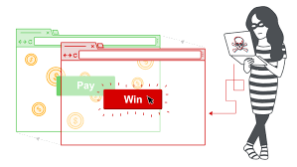
Clickjacking

Slide 45
Clickjacking
What is it?
Tricking a user to perform an action they didn’t mean to perform
Usually this is in the form of overlaying an iframe of a legitimate website, on top of a button on an illegitimate website
Why should I care?
Could allow malicious users to trick privileged users to take actions they shouldn’t be taking
Yes even internal apps are susceptible

Slide 46
Clickjacking
How do I fix it?
Restrict who can IFrame your web app
Apply the X-Frame-Options header with the value none or Content-Security-Policy with frame-ancestors setting to none

Slide 47
Clickjacking Demo

Slide 48
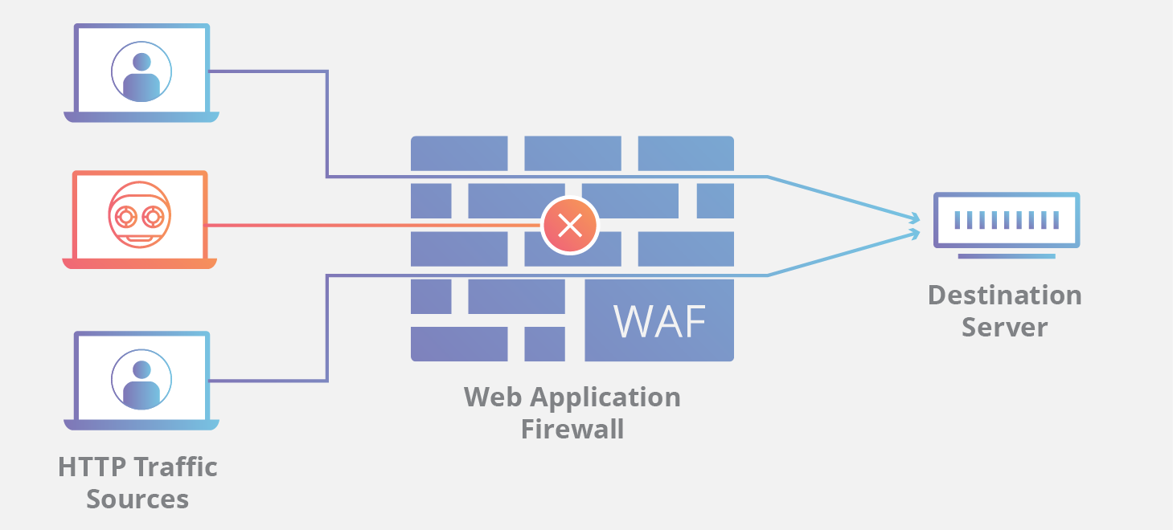
Lacking a WAF

Slide 49
Lacking a WAF
What is it?
Web Application Firewalls protect against many attacks (DDOS, scans, etc)
Why should I care?
First line of defense against malicious attackers

Slide 50
Lacking a WAF
How do I fix it?
Purchase a WAF (i.e. Cloudflare, Imperva, Azure WAF, AWS WAF, etc)

Slide 51
Takeaways
Awareness different security vulnerabilities your web apps might have
More than just OWASP Top 10

Slide 52

Questions? Contact: ssauber@leantechniques.com
Slides at scottsauber.com
scottsauber

Slide 53
Thanks!
Slides at scottsauber.com
scottsauber

